Slide 1
Python project
Computer Hardware + parallelization
- Kevin Kung

Slide 2
Contents
Software
Hardware
Program/Code
How it works
Parallelization + examples
Why not multithreading
Questions

Slide 3
Python
I chose python to base my program on, a feature/module of python which can run games – pygame.
This is because I wanted to make an external piece of hardware – controller – connect with a programming language – python – since it’s the one I have the most knowledge of thus far.

Slide 4
Hardware
I wanted to make use of a gaming controller so I looked for ways to make a program which could use the button inputs from a controller to emulate actions on a screen, inside a program.
Connects via Bluetooth but can also be detected through a USB cable
I wanted to use the axis controls of the joystick as movement rather than the D-Pad since it gives the user more room for error and for smoothness.

Slide 5
Program
The program itself comes from games from my childhood.
I wanted to replicate a car dodging game with the perspective of side scrolling.
It includes randomly generated cars ‘spawning’ in various areas of the x axis along with their hit boxes – though a bit wonky.
Has multiple button prompts to quickly exit the game or start and restart.

Slide 6
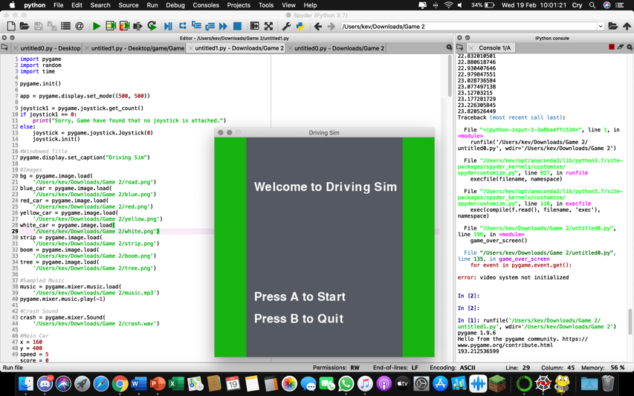
Code
So this is roughly what you’d see when running the code.
A program to give options as the code loads up assets from the folder in the background.
Button inputs are mapped to the controller.

Slide 7
Problems I faced
Coming up with a concept
Working around pygame’s commands – JOYSTICKUP/DOWN, events, initializing controllers
The sizes and positions of the hitboxes/icons
Adjusting the speed/velocity of the blocks
Making the game work around the joystick rather than D-Pad

Slide 8
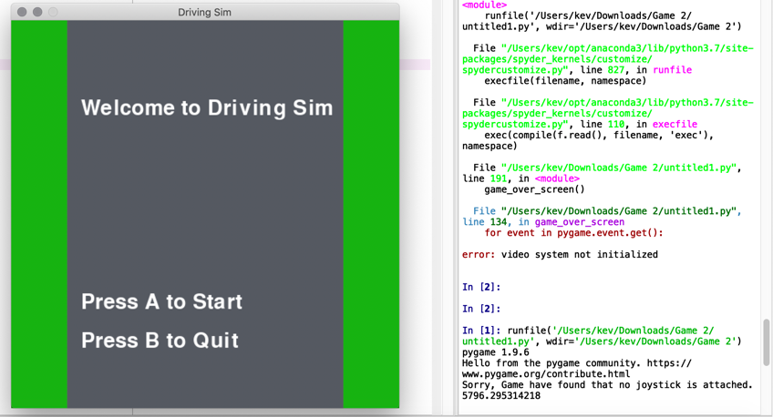
Detection
If the program cannot detect a controller, it will still run though nothing can be done since inputs from the keyboard haven’t been included and the user will be shown that there is no controller/joystick connected.

Slide 9
Parallelizing the program
Why parallelize it?
When running the program, some assets, like images, can load in and load out much faster than without multiprocessing.
This lessens the time it takes to import the images of trees and cars from the folder to the program and project it to the windowed program.
Gives more CPUs for the computer to use to load faster.

Slide 10
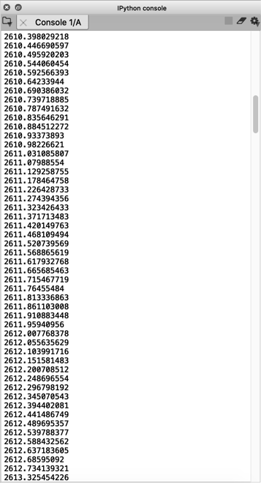
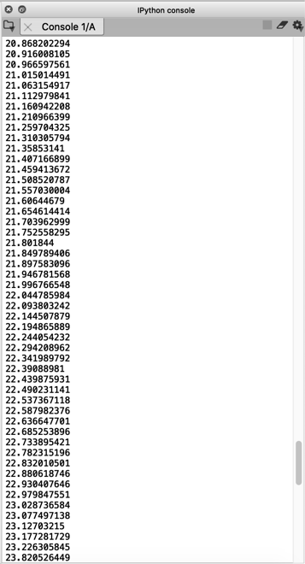
Examples
Left features the program running without multiprocessing imported.
Right features the program with multiprocessing.
A very substantial difference when it comes to loading the images in the least amount of time.

Slide 11
Why not multithreading
Multithreading includes generating more threads which increases a computer’s speed. I felt like it wasn’t as necessary over multiprocessing since loading images could benefit more from more CPUs.
I went with multiprocessing since it takes advantage of multiple CPUs and cores, making it easier to load up the program each time.

Slide 12
Questions
Any questions, ask away.

